Slide 1
SQL Project on Visible Learning Enhancement Solutions
Prepared by: Vithika Singh (56)

Slide 2

About Company
Visible Learning Enhancement Solutions are corporate training and executive coaching organisation focusing on enablement.
They have subject matter experts in human behaviour transformation.
They provide customised learning & coaching solutions based on the objectives and long term goals.
They focus on the positive attitudinal shift of the learner for long lasting learning impact.
Some of the model followed by the company for coaching are:
ADDIE model
4 Principle of Andragogy
Services provided by them:
Coorporate Training
Executive coaching
Business Consulting

Slide 3
Data points
As VLES provides coaching and training to other organisation it would be storing details of the whole process.
Clients and portfolio of trainings which they provide was available on their site.
So following are the data points I arrived on:
Clients
Portfolio_training
Employee_personal_details
Employee_office_detail
Employee_client
Training_details
Client_account
Salary_account
Training_evaluation
Feedback

Slide 4
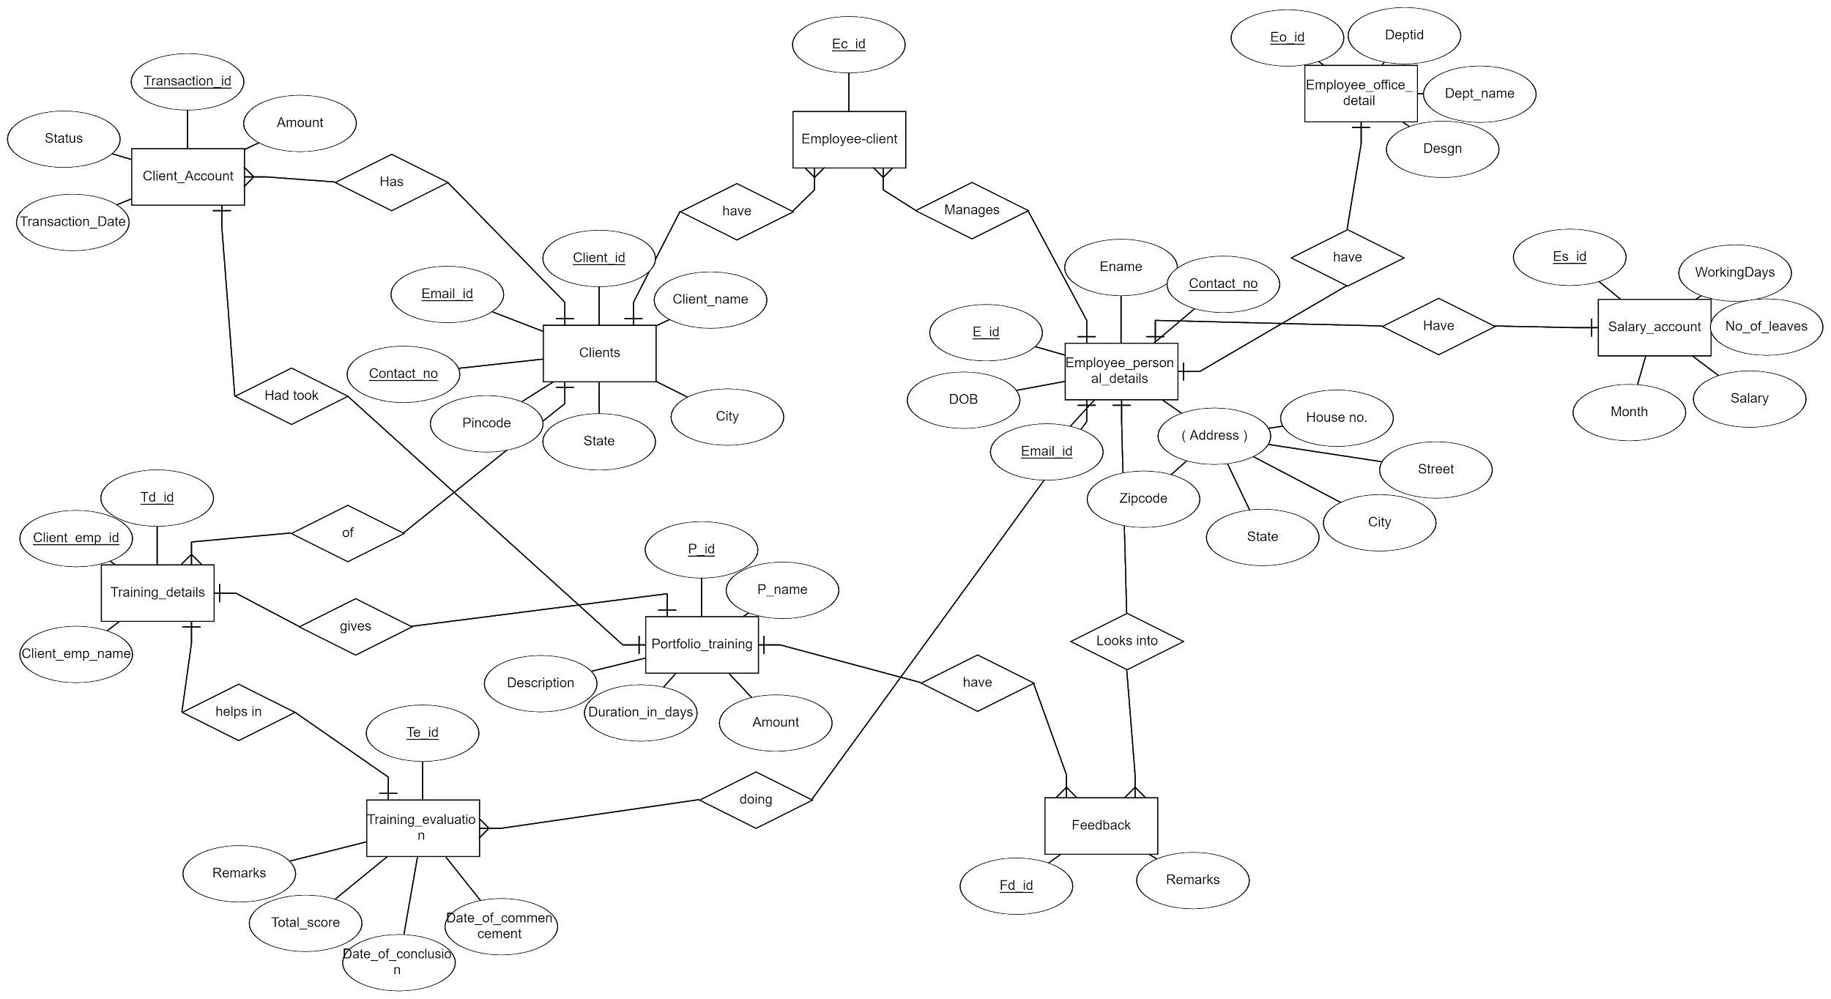
ER diagram

Slide 5
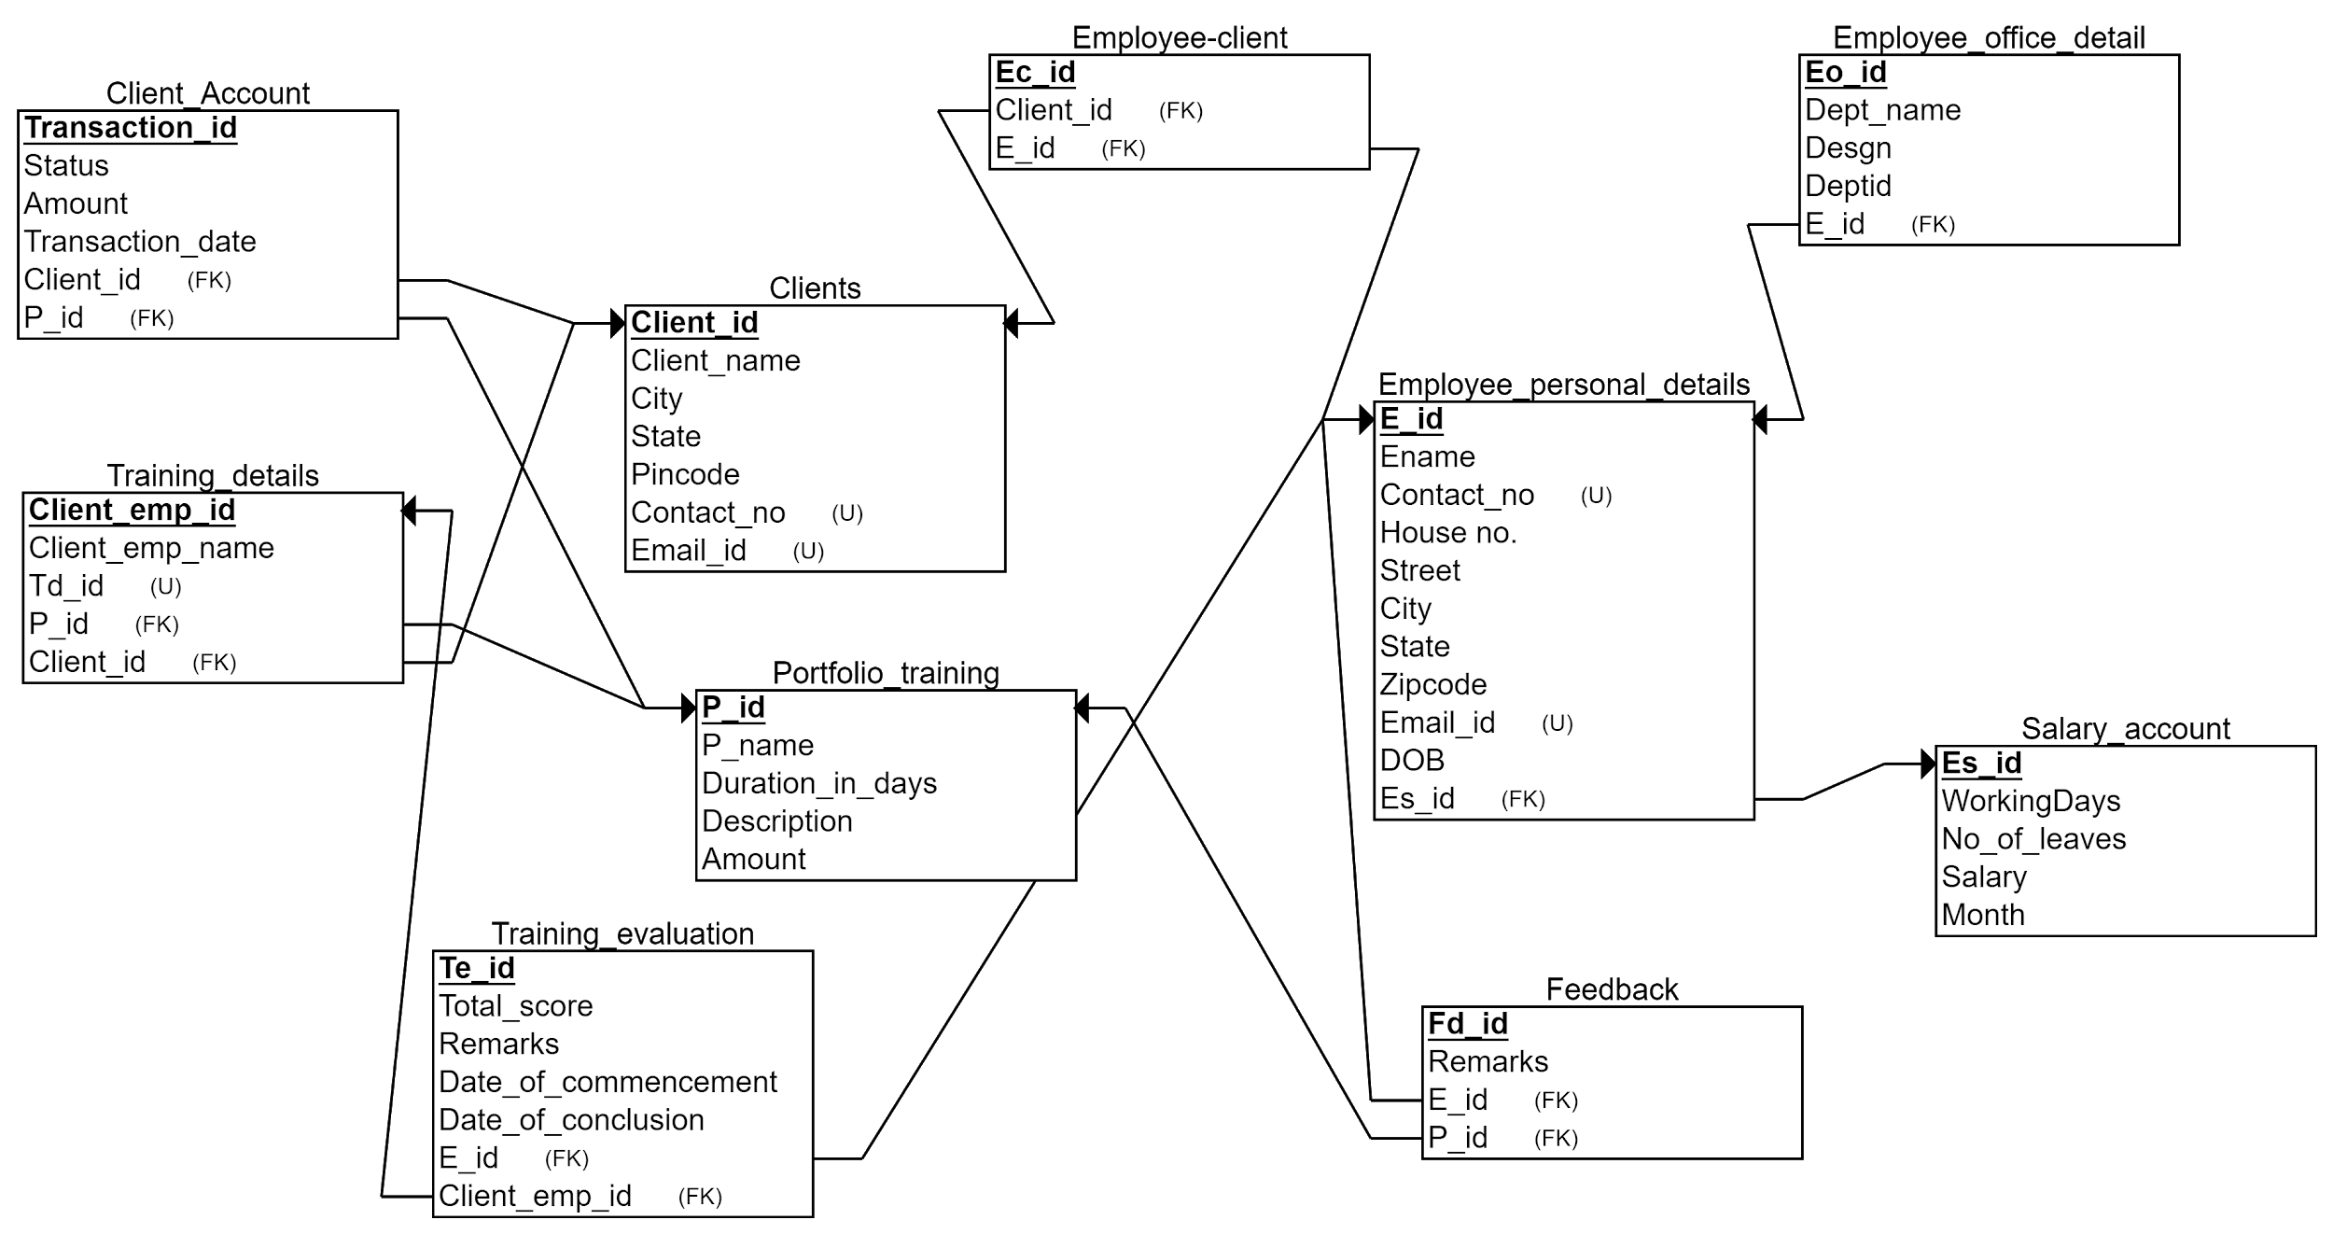
Relational Schema

Slide 6
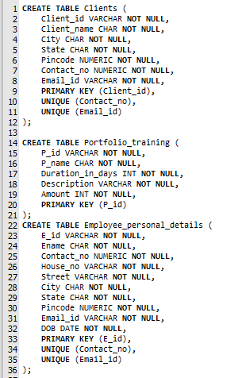
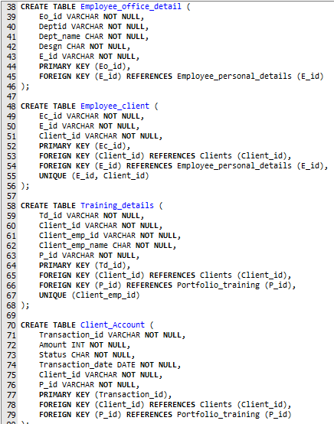
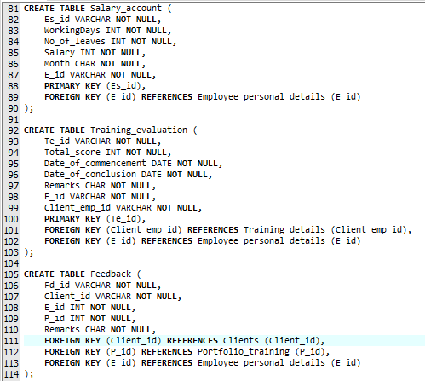
Table creation

Slide 7
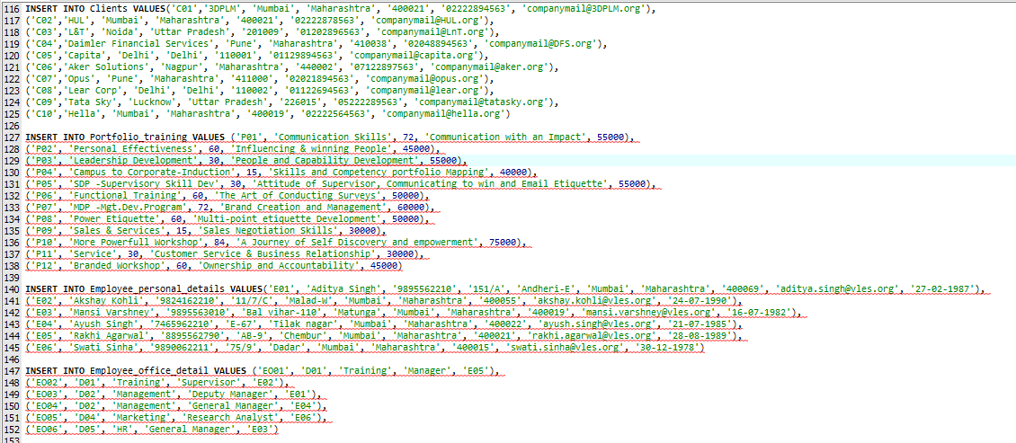
Data entry

Slide 8
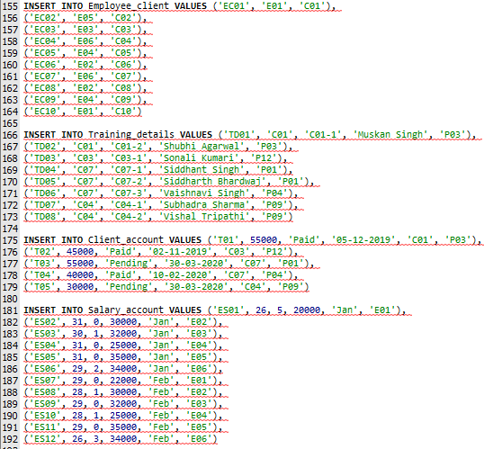
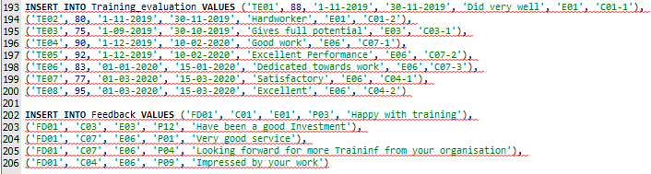
Data entry(contd.)

Slide 9
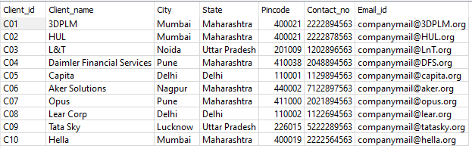
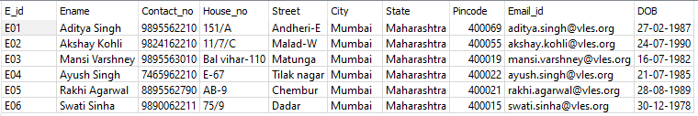
Snapshot of database
Clients table
Employees_personal_detail table

Slide 10
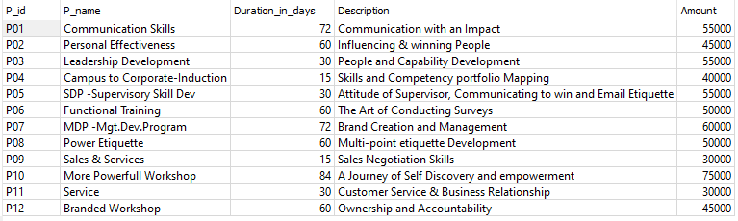
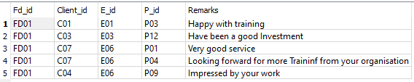
Snapshot(contd.)
Portfolio_training table
Feedback table

Slide 11
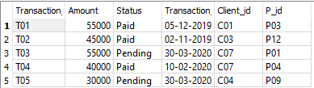
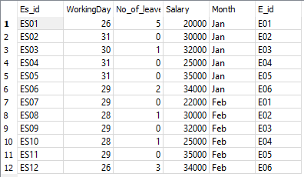
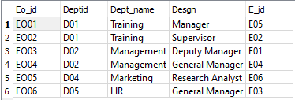
Snapshot(contd.)
Client_account table
Salary_account table
Employee_office_detail table

Slide 12
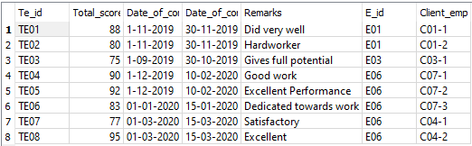
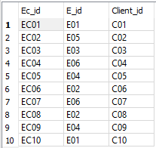
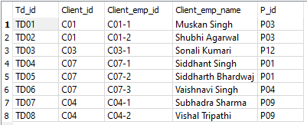
Snapshot(contd.)
Training_evaluation table
Employee_client table
Training_detail table

Slide 13
THANK YOU

